Slide 1
Pop the koinobori
by : X&S

Slide 2

Company name & group members
Group members: XiangYu Hong, Shining Liu
Company name: X&S
Game name: Pop the koinobori

Slide 3
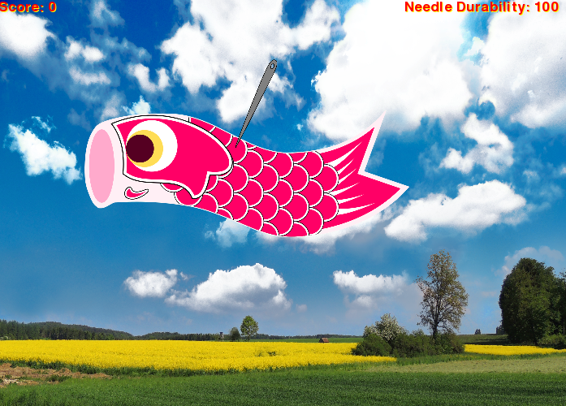
Objects
The objects of the game are the koinobori(a flag) and the needle.

Slide 4
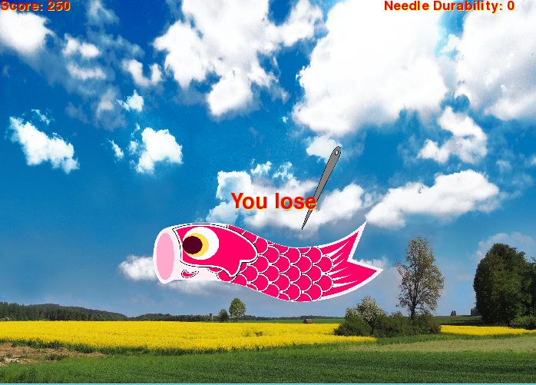
Instruction & goals of the game
You gain points from clicking the koinobori with your mouse 1(Left click), and you lose the needle's durability if you miss clicked the koinobori. You win by reaching the score of 300, and you lose if the needle's durability reached to 0.

